Slide 1
BANK CUSTOMER CHURN DATA ANALYSIS
PROJECT

Slide 2
PROJECT OBJECTIVE
Analyze the customer data of a North American bank and build an interactive dashboard using Tableau. Building a dashboard will involve analyzing the data and presenting the results using appropriate charts/graphs.
BANK CUSTOMER CHURN DATA ANALYSIS
A certain bank in North America wants to perform customer churn analysis, as the credit card business of the bank is not performing very well. Churn analysis will help the bank evaluate the customers who have stopped purchasing the credit card of the bank and figure out measures to reduce the bank's customer loss rate.

Slide 3
DATA CLEANING CONDITION
Perform the below steps on the data before loading the dataset into Tableau Public:
Display the summary statistics of the dataset.
Identify the outliers in the dataset. (if there any)
Identify the missing values in the dataset and display the count of missing values.
Perform data imputation, using whichever method suits most logically for the given columns in the dataset.

Slide 4
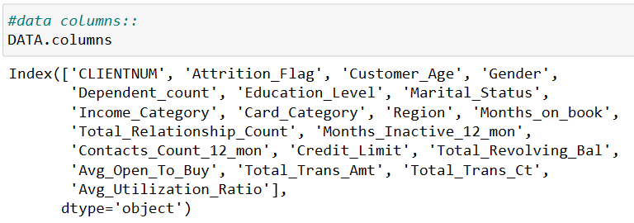
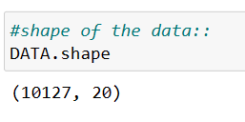
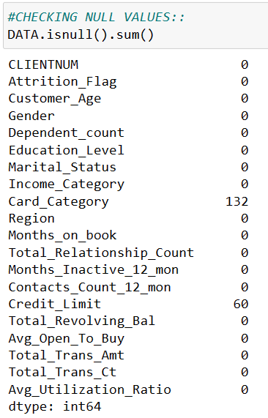
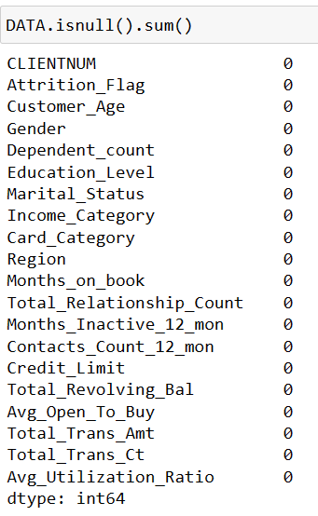
DATA CLEANING PROCESS
After importing Specialized Library, load the data in csv file.
Understanding The Data at Level 0,The shape of the data is 10,127 Rows and 20 Columns.
In the Card Category columns have 132 Null Values.
In the Credit Limit columns have 60 Null Values.
Apply imputations Method we can easily Handle Null Values.
After that understanding the Main Columns like all the Numerical columns and apply Outlier Analysis.
BEFORE
AFTER

Slide 5
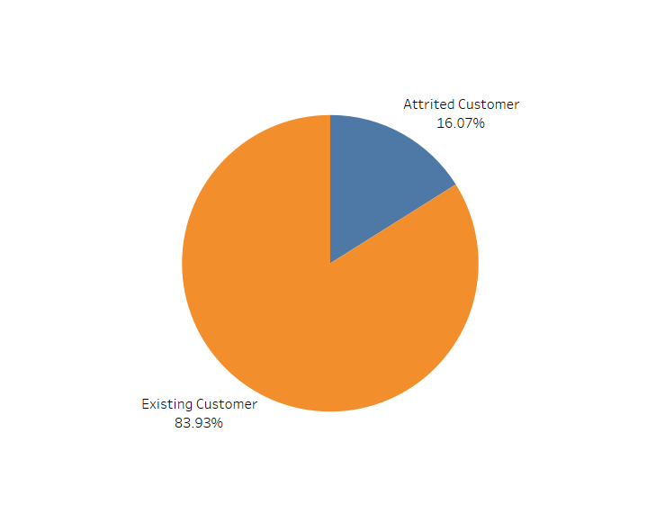
TASK-1
PERCENTAGE OF ATTRITED AND EXISTING CUSTOMER
Display the percentage of the attired and the existing customers from the data.
INTERPRETATION
Mostly Existing Customer are there that is 83.93%
There are 16.07% customers are Attired customer.

Slide 6
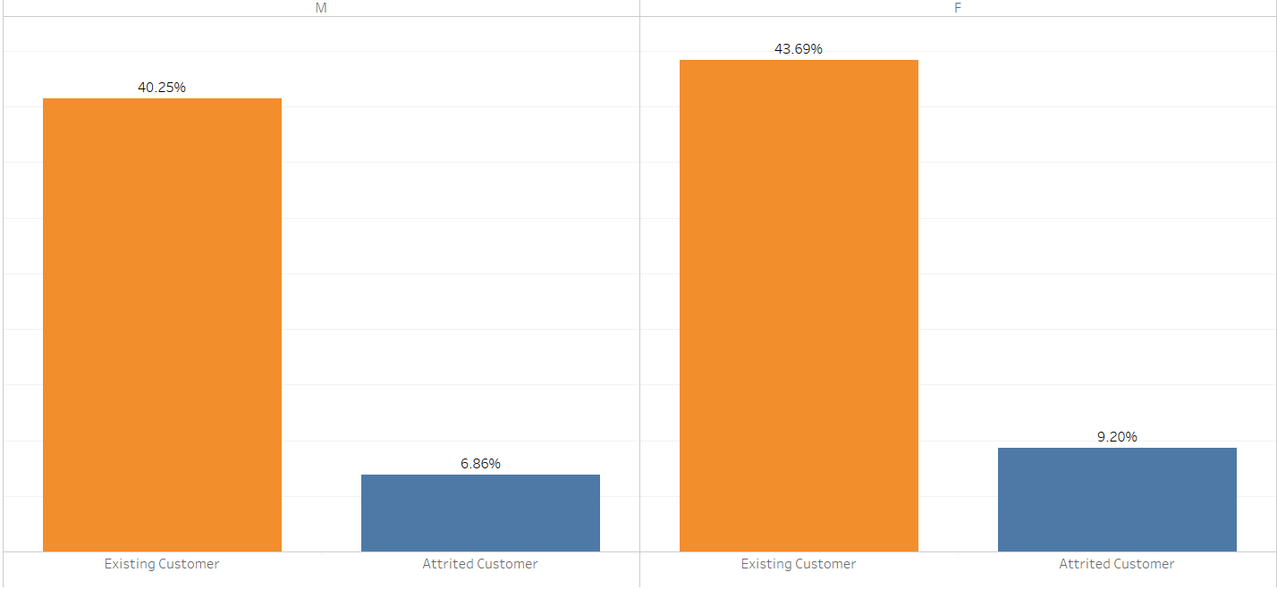
TASK-2
GENDER WISE ATTRITED AND EXISTING CUSTOMER
Display gender-wise percentage of the attired and the existing customers.
INTERPRETATION
There are 40.25% Existing Customer is Male and 6.86% customers are Attired.
There are 43.69% Existing Customer is Female and 9.20% Customer are Attired.

Slide 7
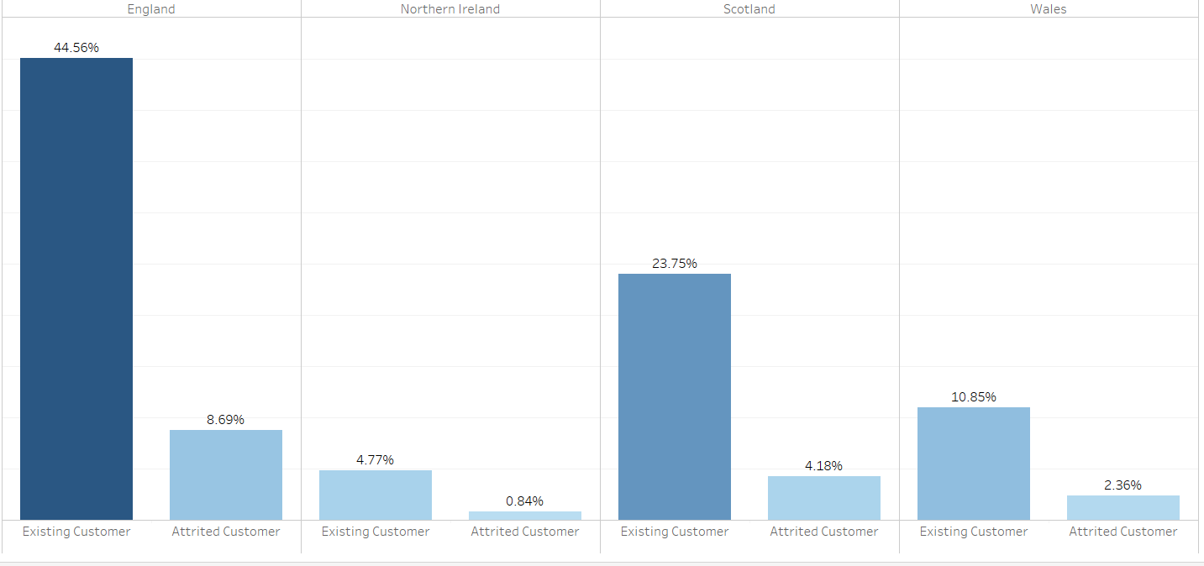
TASK-3
REGION WISE ATTRITED AND EXISTING CUSTOMER
Display region-wise percentage of the attired and the existing customers.
INTERPRETATION
In England and Scotland mostly Customers are Existing customer that is 44.56 % and 23.75%.
Attrited customer in England is 8.69%.

Slide 8
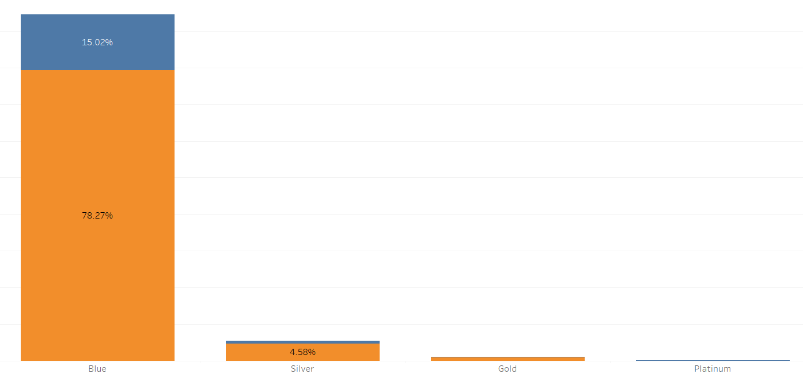
TASK-4
CARD CATEGORY WISE ATTRITED AND EXISTING CUSTOMER
Display the percentage of the attired and the existing customers for each card category.
INTERPRETATION
In Blue Card Category Mostly Customers are Existing Customer that is 78.27% and Attired customer approx. is 15.02%
There are Very less Existing Customer and Attired Customer are in Silver, Gold, Platinum Card Category.

Slide 9
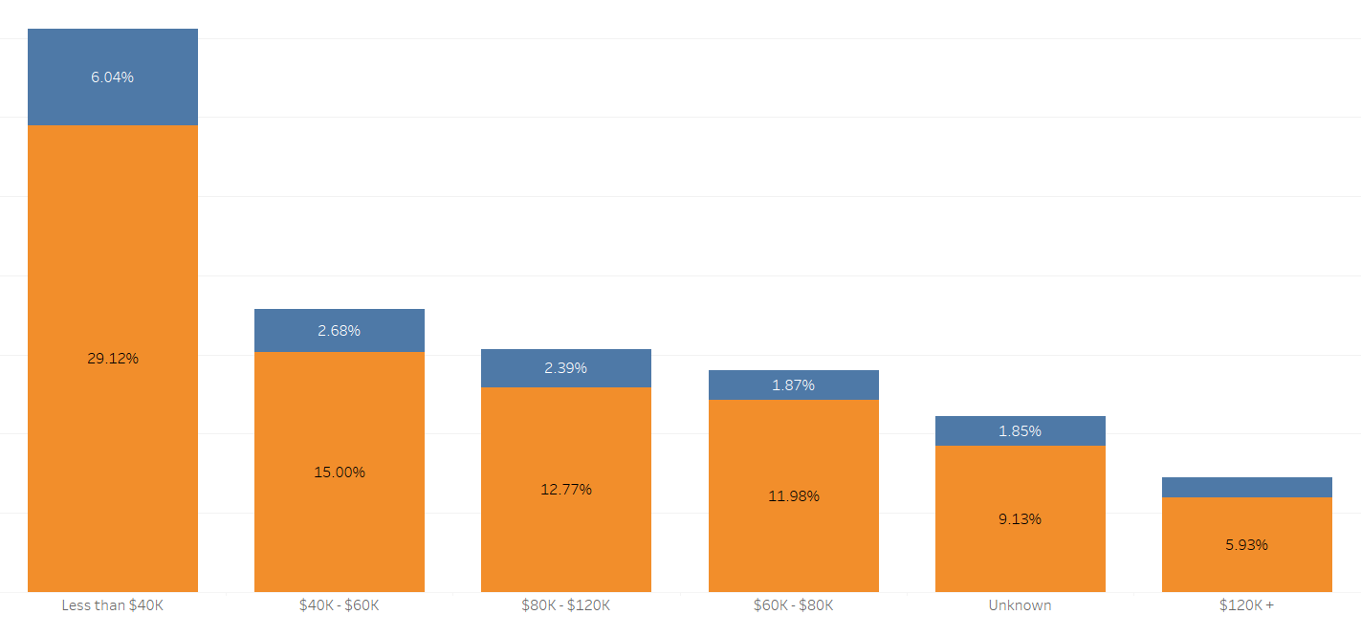
TASK-5
Display the percentage of the attired and the existing customers for each income category.
INCOME CATEGORY WISE ATTRITED AND EXISTING CUSTOMER
INTERPRETATION
Mostly Customer who are Less than $40k are belongs to Existing Customer and the Attired Customer is 6.04%.

Slide 10
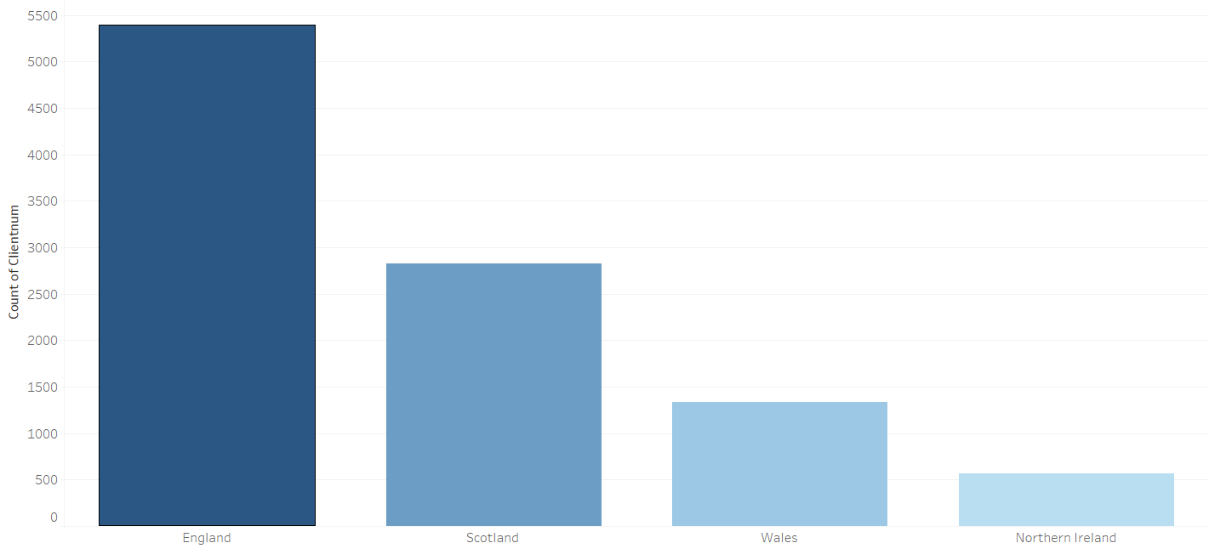
TASK-6
REGION WISE COUNT OF CUSTOMER
Display region-wise count of customers. Identify the region that has the maximum number of customers.
INTERPRETATION
England and Scotland have Highest Number of Customer.
Least Customer are in Netherland.

Slide 11
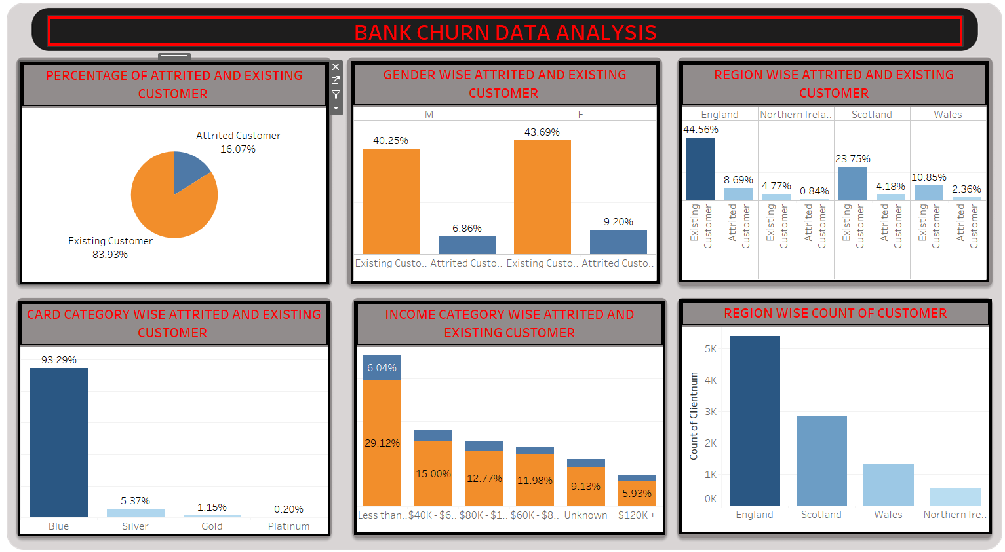
TABLEAU DASHBOARD

Slide 12

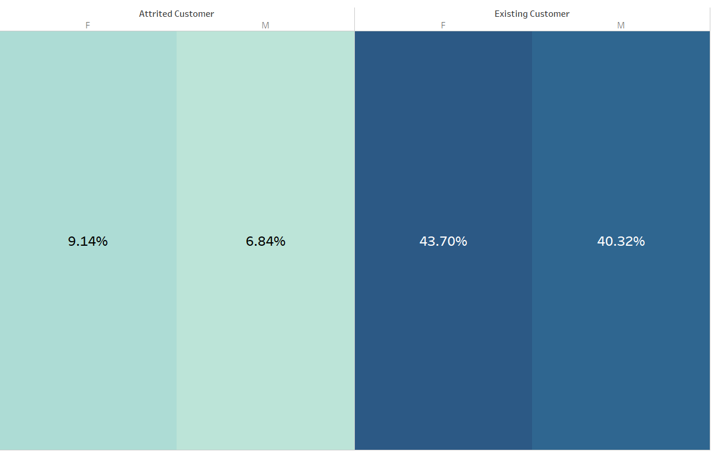
TASK-1
COUNT OF CUSTOMER
Display the Total Number of Customer.
INTERPRETATION
GENDER WISE ATTRITED AND EXISTING CUSTOMER
There are 10,127 Customers.
TASK-2
Display the Gender wise Percentage of Existing customer and Attired Customer.
INTERPRETATION
Females customer are more Attrited than Male Customer.

Slide 13
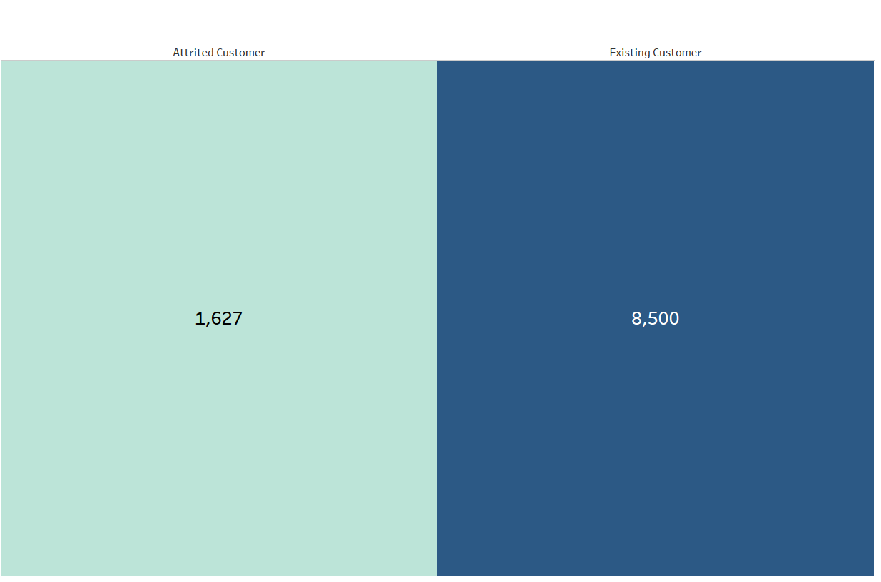
TASK-3
COUNT OF ATTRITED AND EXISTING CUSTOMER
Display the count of attired and existing customer.
INTERPRETATION
There are Total 8,500 Existing Customers and 1,627 Customers are Attired.

Slide 14
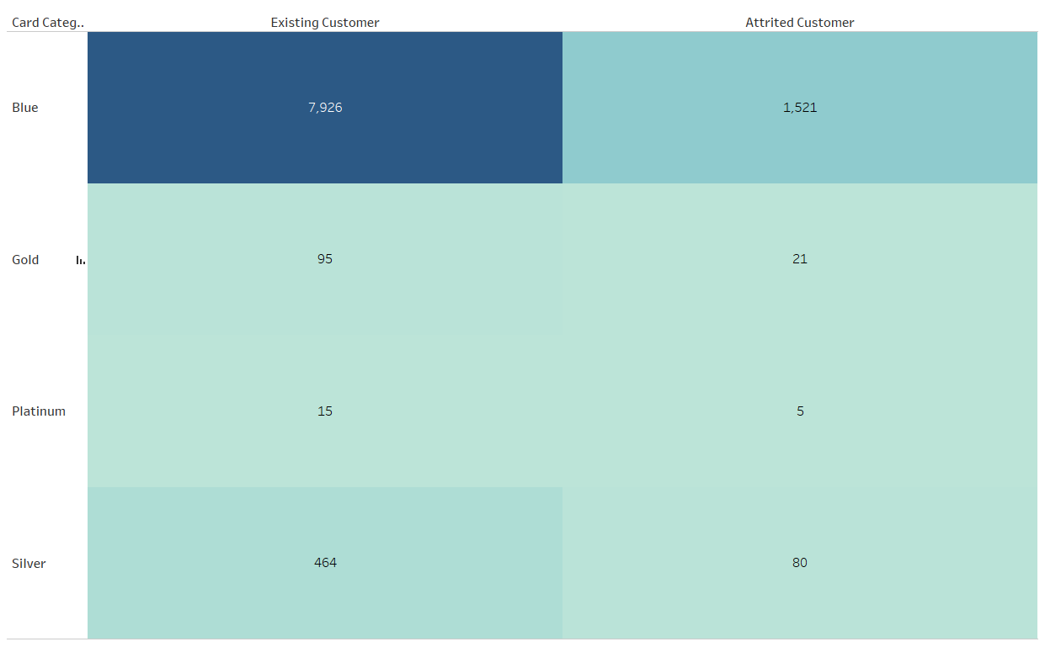
TASK-4
CARD CATEGORY WISE ATTRITED AND EXISTING CUSTOMER
Display the Card Category wise count of attired and existing customer.
INTERPRETATION
Mostly Existing Customer are belongs to Blue Card Category and Attrition of Customer are also high that is 1,521 Customers.

Slide 15
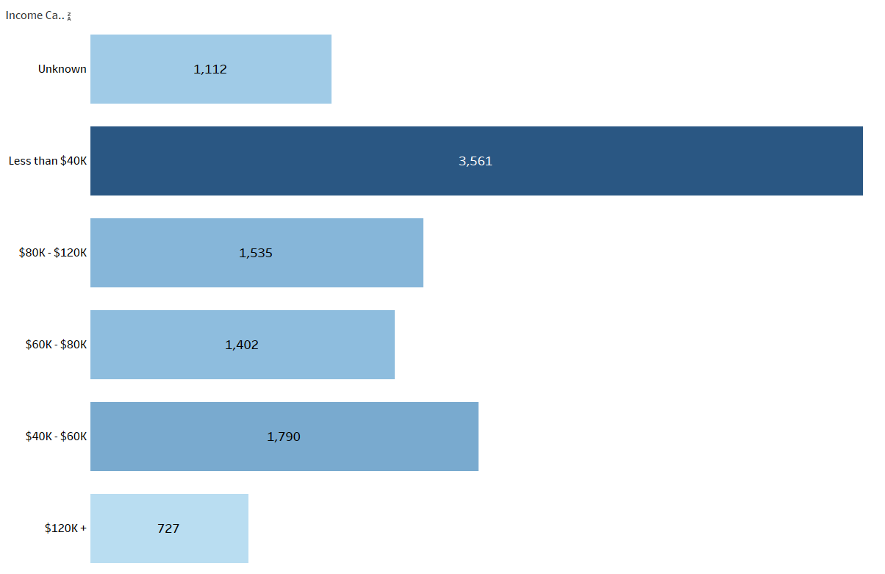
TASK-5
INCOME CATEGORY WISE COUNT OF CUSTOMER
Display the Income Category wise count of customer.
INTERPRETATION
Mostly Customers are Belongs Less to than $40k and $40k-$60k.

Slide 16
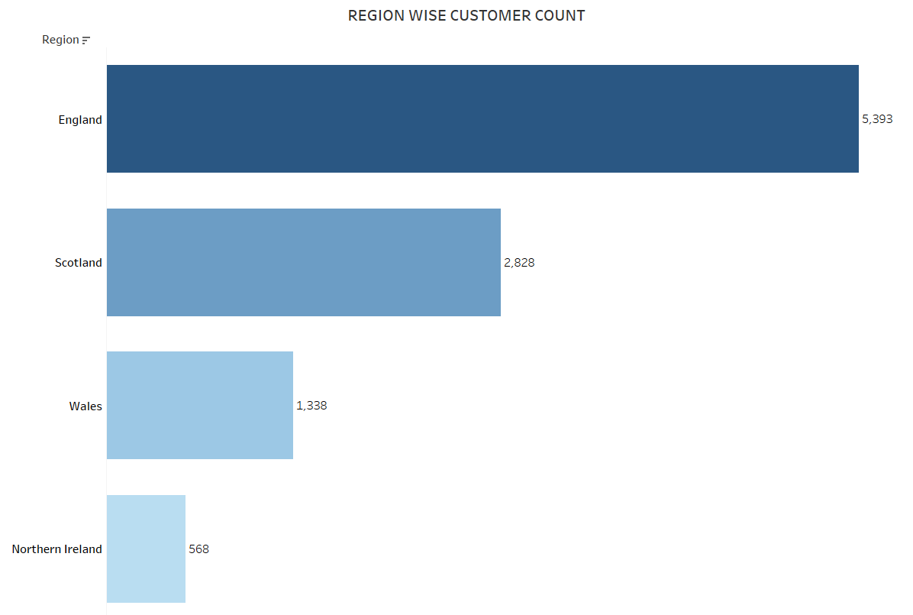
TASK-6
REGION WISE COUNT OF CUSTOMER
Display the Region wise count of customer.
INTERPRETATION
Mostly customer are Belongs from England and Scotland.

Slide 17
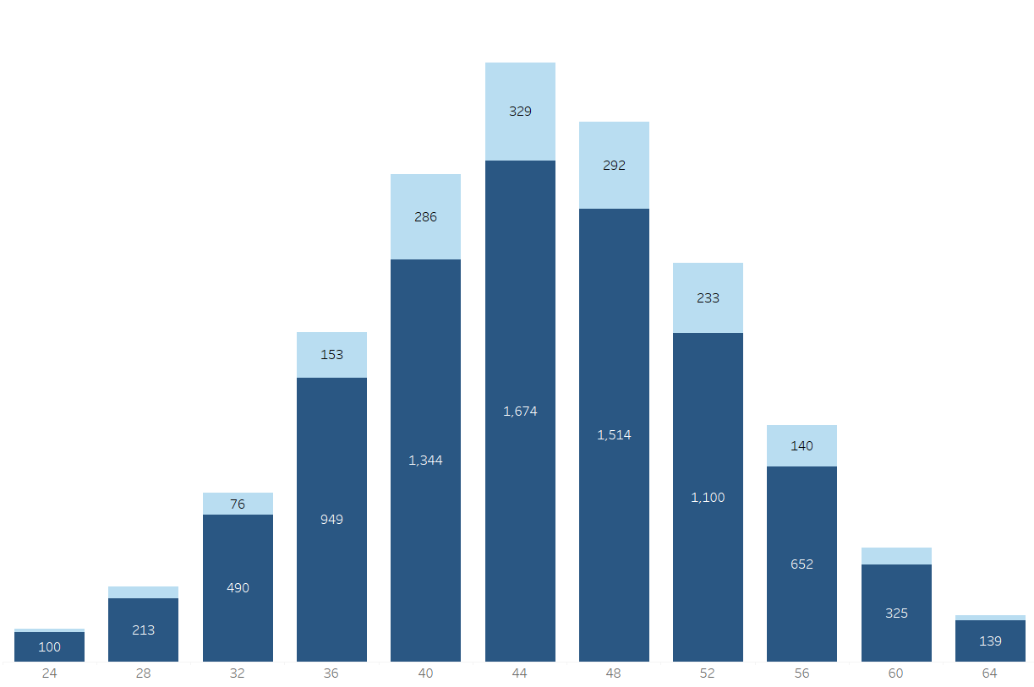
TASK-7
AGE GROUP WISE ATTRITED AND CUSTOMER COUNT
Display the Age group Wise Attired and Existing Customer.
INTERPRETATION
Total 329 customer are Attrited in the 44 Age Group wise .

Slide 18
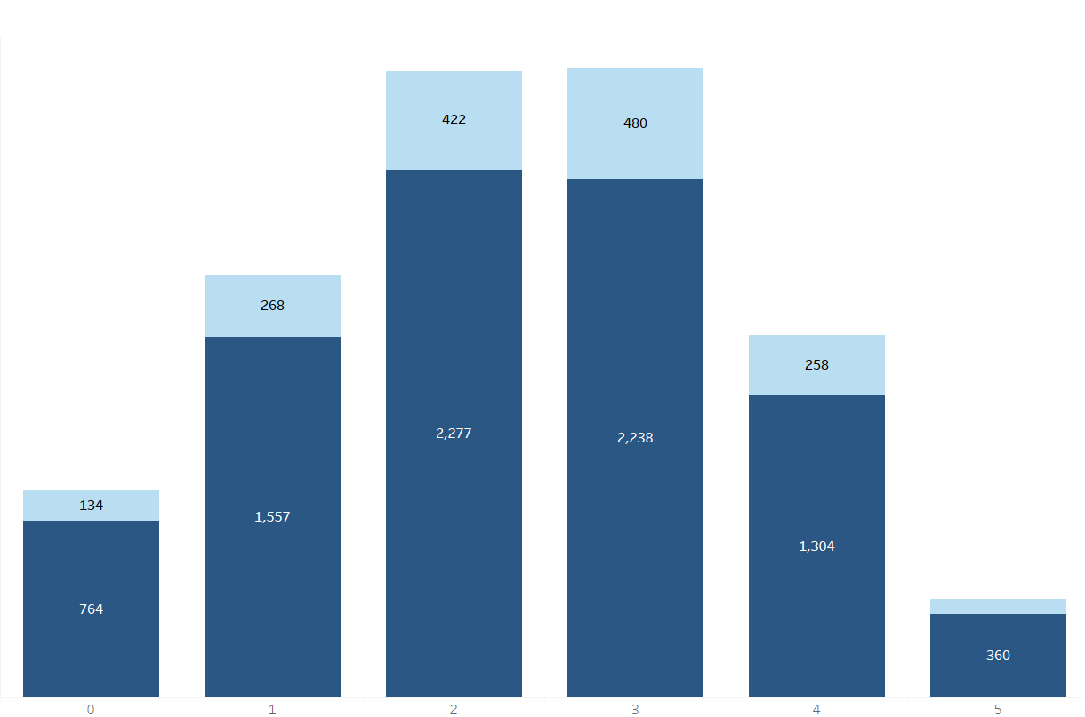
TASK-8
DEPENDENT WISE COUNT OF ATTRITED AND CUSTOMER
Display the Dependent wise of Attired and Existing Customer.
INTERPRETATION
Those are 2 and 3 Dependent the Attrition Count is High.

Slide 19
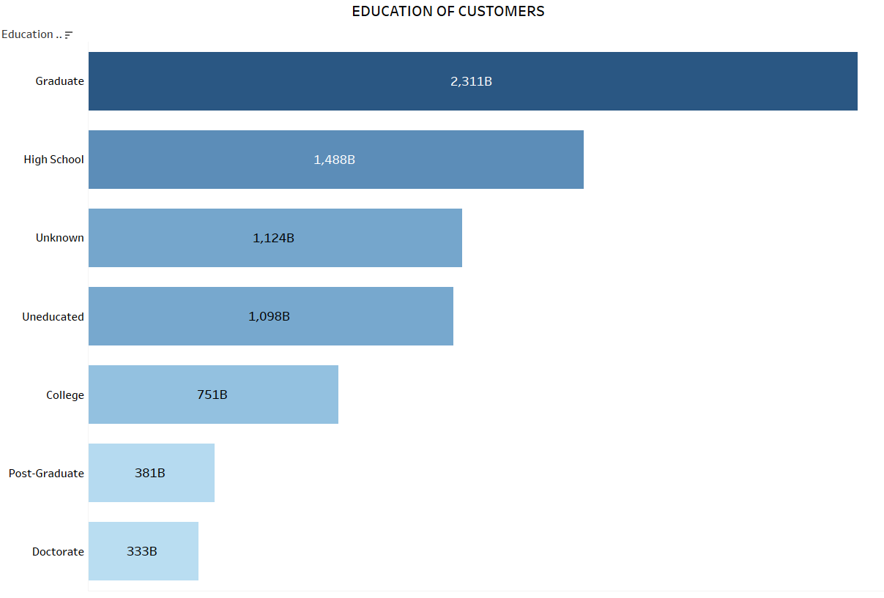
TASK-9
AVERAGE UTLIZATION VS CREDIT
Display the Education Wise count of Customer.
INTERPRETATION
Mostly Graduate Customer are from Graduation and High schools Education.

Slide 20
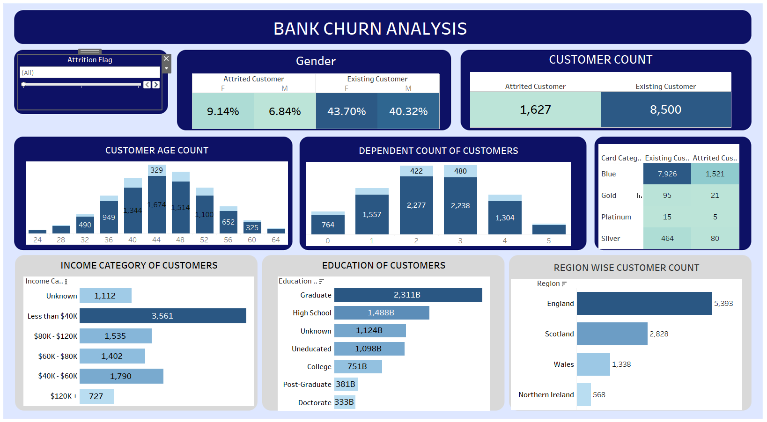
DASHBOARD

Slide 21
CONCLUSION
There are Total 1627 Customer who are Attired. The Attrition Rate is 57.18% in Female and 42.82% in Male. Mostly 40-44 and 44-28 Age group are Attired more than other Age Group. Those who Dependent of 2 and 3 are also more Attired. Mostly Existing Customer are Belongs From Blue Card Category but Count of Attired Customer are High as compared to Other Card Category. Those Who are Earning less than $40k and $40k-60k the Attired customer are more. In the Region of England the Attired Customer is Approx. 800

Slide 22
THANK YOU
VIPUL GOUR

